Slide 1
LTC2369-18, LTC2370-16
18-bit 1.6Msps and 16-bit 2Msps Pseudo-Differential Unipolar
SAR ADC Family

Slide 2
Introduction
Purpose:
  Provide an overview of the LTC2369-18 and LTC2370-16 SAR ADC Family
Objectives:
  Cover the Key Features
  Highlight Pseudo-Differential Input Drive
  Highlight Longer Acquisition Time
Notes:
Welcome to the Linear Technology LTC2369 video product brief. This video will provide you an overview of the LTC2369-18 and LTC2370-16 family of 18 and 16-bit Pseudo-Differential Unipolar SAR ADCs. We will go over the key features and discuss the advantages of the Pseudo-Differential Input drive and Longer Acquisition Time featured in these ADCs.

Slide 3
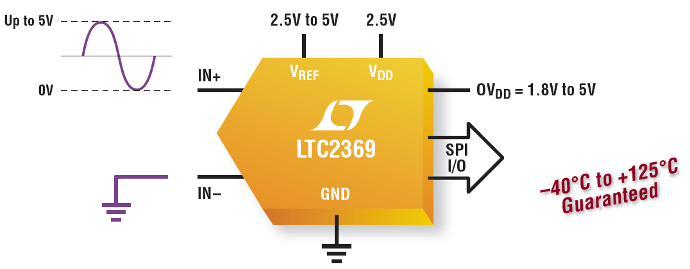
LTC2369-18 Family Overview
Up to 1.6Msps Throughput Rate. No Cycle Latency
96.5dB SNR (Typ) –120dB THD (Typ) at f_{IN} = 2kHz
±2.5LSB INL (Max), ±0.5LSB DNL (Max)
Low Power: 18mW at 1.6Msps, 18μW at 1.6ksps
16-Lead MSOP and 4mm × 3mm DFN Packages
Notes:
The LTC2369 is a family of serial 18- and 16-bit pseudo-differential SAR analog to digital converters (ADCs), that achieves impressive 96.5dB SNR and -120dB THD at 18 bits, with No Cycle Latency, while supporting a 0V to 5V unipolar input range . In addition to the outstanding AC performance and fully guaranteed specifications over a wide -40ºC to 125ºC temperature range, the LTC2369 family offers excellent DC performance including very low offset error and outstanding INL and DNL performance. The fully tested and guaranteed AC and DC specifications ensure designers can design to datasheet specifications without compromise.
The 18-bit LTC2369-18 is the industry’s highest performing 18-bit pseudo-differential SAR ADC featuring a maximum INL of ±2.5LSB with no missing codes and 1.6Msps sample rate. The pin-and-software compatible 16-bit LTC2370-16 complements the LTC2369-18 with excellent 94dB SNR at 2Msps and ±0.85LSB maximum INL performance.
The LTC2369 family offers a 0V to V_{REF} Pseudo-differential unipolar input range with V_{REF} ranging from 2.5V to 5V. The pseudo-differential input simplifies the ADC driver requirement, enabling single-ended drive while benefiting from the reduction of unwanted signals common to both inputs. The pseudo-differential input also reduces complexity and lowers the power requirements in the signal chain. Operating from a 2.5V supply, the LTC2369-18 consumes only 18mW, with a low power shutdown mode that consumes just 2.25µW. When used in combination with a single-ended ADC driver, the combined solution offers significantly lower power dissipation in the signal chain.

Slide 4
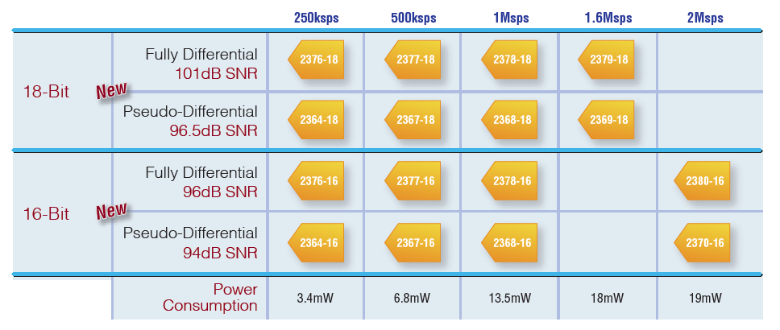
LTC2369-18 Pseudo-Differential Drive Family
Pseudo-differential drive ≈ ½ the cost, complexity, power in driver
Pin- and timing-compatible with LTC2379 fully differential family
Notes:
The LTC2369 family is pin- and timing-compatible with our 250ksps to 2Msps, , LTC2379 family of fully differential SAR ADCs with up to 102dB SNR. The LTC2369 family also offers a user-friendly SPI interface, dedicated Busy and Chain pins, I/O voltages from 1.8V to 5V and an internal oscillator, that helps simplify digital timing and minimize external component count. Their true no-latency operation enables accurate one-shot measurements even after lengthy idle periods with no minimum sample rate required. Major advantage also includes low power operation, where the power dissipation scales linearly with the sample rate. At 2Msps the 16-bit LTC2370 consumes 19mW, and the power consumption scales down to 3.4mW at 250ksps.
When compared to the fully differential LTC2379 family, the pseudo-differential LTC2369 family offers the option to use a lower power, less complex and cheaper ADC driver, at the cost of a slightly lower SNR performance.

Slide 5
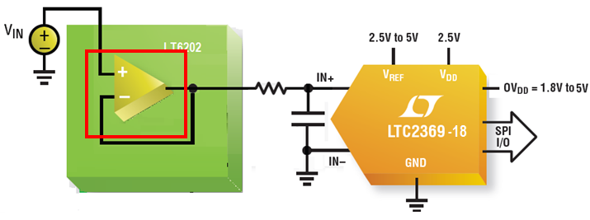
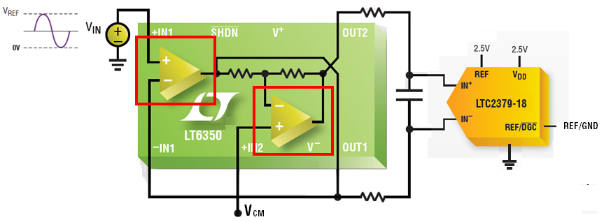
Pseudo-Differential vs. Fully Differential ADC Driver
 | Split Supply ADC Drivers
Pseudo-Differential ADC | PD w/ split +7.5V, -2.5V supplies=3mA*(10V)+18mW= 48mW (96.5dB SNR)
Fully Differential ADC | PD w/ split +7.5V, -2.5V supplies= 5.4mA*(10V)+18mW = 72mW (101.2dB SNR) PD w/ single 5V supply and DGC =4.8mA*(5V)+18mW = 42mW (99dB SNR)
PD = Power Dissipation , DGC = Digital Gain Compression, w/ = with
Notes:
Choosing either a fully-differential ADC or a pseudo-differential ADC depends on the accuracy required and on the signal conditioning circuitry of the application. In most applications an amplifier level-shifts, scales, filters and drives the input signal into the ADC. The figure above shows how a single-ended 0V to V_{REF} input signal is driven into the LTC2369 pseudo-differential ADC vs. the LTC2379 fully-differential ADC. Since these ADCs are so low power to begin with, much of the power of the signal chain solution will be in the ADC driver. There are two straightforward ways to decrease power consumption in the driving stage; limiting the circuit complexity of the amplifier, and reducing the required supply voltage.
Traditional single-ended to differential ADC drivers like the LT6350 (shown in the lower circuit), have split ±V_{CC} supply, two internal amplifiers and other discrete circuitry to drive the fully differential inputs of the LTC2379. The LT6202, driving the single-ended input of the LTC2369 (shown in the upper circuit), also has split ±V_{CC} supply but only one internal amplifier. The reduced number of amplifiers, in the driver for the pseudo-differential ADC, reduces the cost and complexity of the input driver, and consumes less power (30mW vs. 54mW) than a fully differential ADC driver.
The second way to reduce amplifier power is to move from a dual supply (eg. -2.5V,+7.5V) to a single supply solution. The tradeoff for lower supply voltage is that the output swing of the amplifier is reduced and hence a slightly lower SNR performance is achieved. The LTC2379 family offers an innovative Digital Gain Compression (DGC) feature which eliminates the driver amplifier’s negative supply while preserving the full resolution of the ADC. When enabled, the ADC performs a digital scaling function that maps zero-scale code from 0V to 0.1 • V_{REF} and full-scale code from V_{REF} to 0.9 • V_{REF}, allowing the amplifier to operate from a single positive supply. The elimination of the negative supply dramatically reduces the total power consumption of the signal chain while simplifying the design.

Slide 6
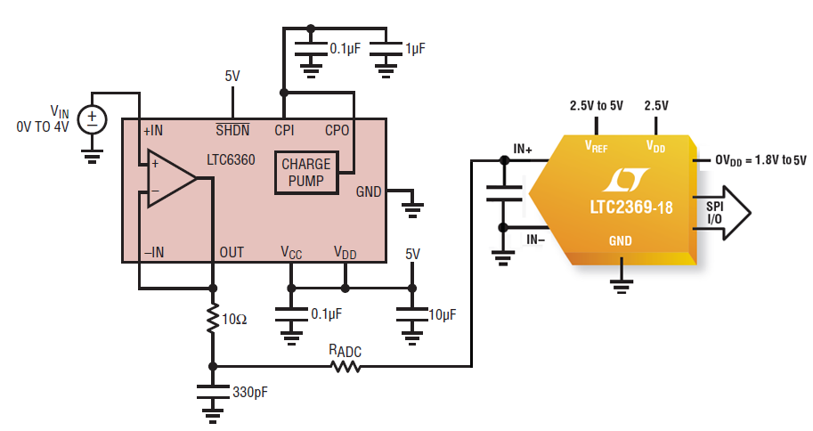
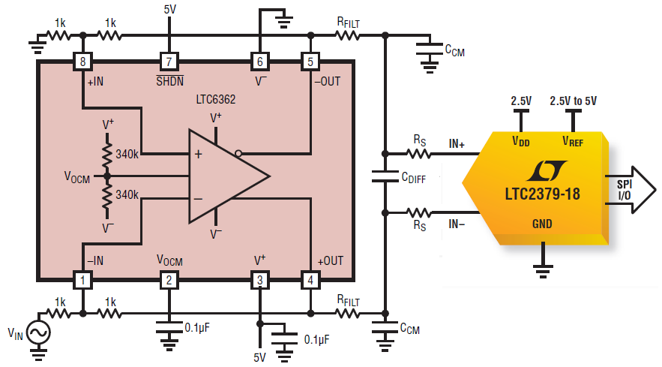
Pseudo-Differential vs. Fully Differential ADC Driver
 | Single Supply ADC Drivers
Pseudo-Differential ADC | PD w/ single 5V supply=17.5mA*(5V)+18mW=105.5mW (≈93dB SNR,V_{REF}=4.096V )
Fully Differential ADC | PD w/ single 5V supply and DGC = 1.06mA*(5V)+18mW = 23.3mW (≈99dB SNR)
PD = Power Dissipation , DGC = Digital Gain Compression, w/ = with
Notes:
These circuits show two different approaches for eliminating the negative rail. The resulting power consumption can be surprising, due to the architectures and speeds of the two amplifiers shown here. A negative supply was used in the previous split supply circuits to allow the amplifier to drive all the way to zero volts, thus matching the input range of the ADC. The LTC6360 (shown in the upper circuit) takes a different approach: it creates its own negative rail with an internal low noise charge pump. This allows its output to swing all the way to zero volts on a single 5V supply. The LTC6362 (shown in the lower circuit), is designed to drive the LTC2379. In this case, the unique feature of the LTC2379, digital gain compression sets the ADC input range to 10% to 90% of the reference voltage, allowing the LTC6362 to drive its full scale on a single 5V supply.
The single-ended LTC6360 has a significantly higher power dissipation of 87.5mW due to the internal charge pump and faster settling time; it offers 93dB SNR performance with the LTC2369. The fully differential LTC6362 offers lower power dissipation of 5mW along with exceptional 99dB SNR performance when combined with the fully differential LTC2379. In summary, the single supply ADC drivers eliminate the negative rail while reducing the complexity of the system and the LTC6362 used with the digital gain compression also helps lower the power dissipation in the signal chain.

Slide 7
Pseudo-Differential vs. Fully Differential ADC Driver
 | LT6202 | LTC6360 | LT6350 | LTC6362
Input | Single-ended | Single-ended | Single-ended | Single-ended or Differential
Output | Single-ended | Single-ended * | Differential | Differential
Power Consumption | 30mW (±5V) | 87.5mW (5V) | 54mW (±5V) 24mW (5V, DGC) | 5mW (5V)
Settling Time | 85ns | 45ns | 200ns | 230ns
90dB HD2/HD3 @ | 300kHz | >1MHz | 200kHz | 40kHz
Noise | 1.9nV/√Hz | 2.3nV/√Hz | 8.2nV/√Hz | 3.9nV/√Hz
* LTC6360 uses an internal charge pump: Outputs can drive to true 0V with single 5V supply.
Notes:
The table here compares the four amplifiers shown previously. It also highlights the speed, distortion, signal bandwidth and noise performance specifications offered by these amplifiers. All these specifications along with the overall power dissipation and SNR requirements of the system, are important to consider when selecting a driver for the ADC.

Slide 8
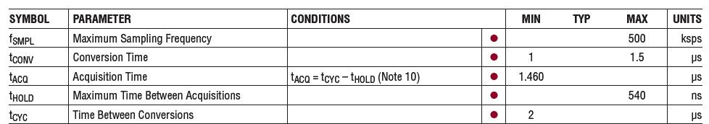
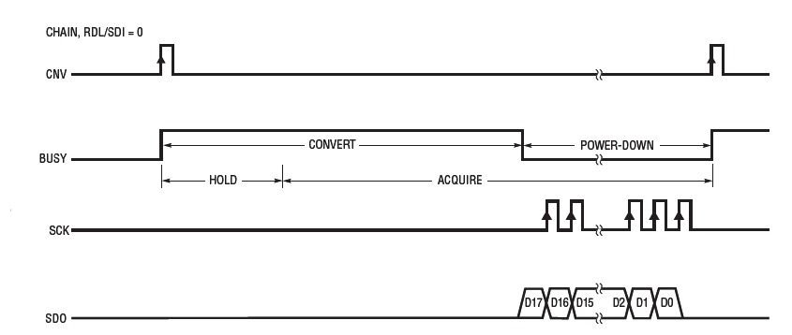
Longer Acquisition Time
Longer Acquisition Time enables slower, low power ADC Driver
LTC2377/LTC2367 Specs:
Notes:
In the slower SAR ADCs below 1Msps such as the LTC2367, LTC2377, LTC2364 and LTC2376, a proprietary sampling architecture extends the acquisition time, 2 to 3 times longer than competitive products. This extended acquisition time eases settling time requirements and enables pairing with slower, much lower power ADC drivers, thus dramatically reducing the overall power required by the solution. Since most of the power of the signal chain solution will be in the ADC driver, by allowing a 2 to 3 times reduction in the driver’s speed, we can achieve almost 2 to 3 times reduction in the driver’s power dissipation. Coupled with the simple driver for pseudo-differential inputs, a 40% or more reduction in the overall power of the signal chain solution can be achieved with the LTC2367 and LTC2364 SAR ADCs.

Slide 9
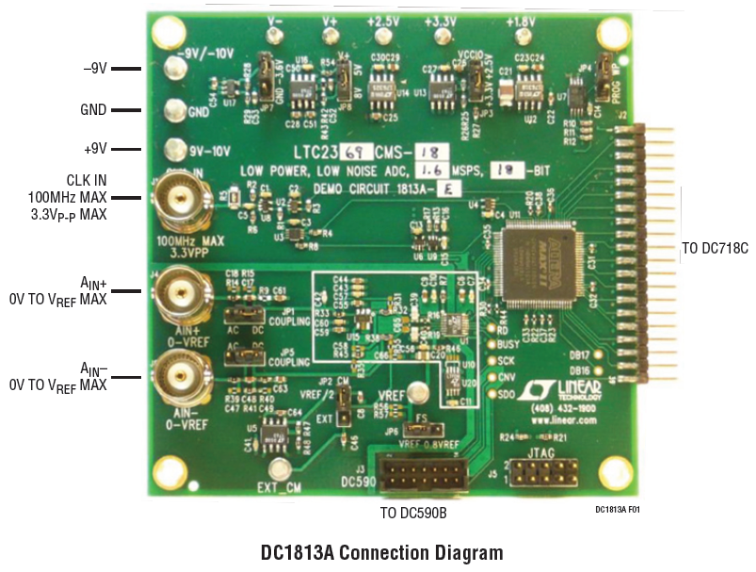
LTC2369 Family Demo System
LTC2369 family is supported by DC1813 demo board
Features the LTC6655 reference and the LT6202 ADC Driver
Interfaces with the DC718 or DC590 data collection boards
Notes:
The DC1813 demonstrates the DC and AC performance of the LTC2369 family in conjunction with the DC590 QuikEval™ and DC718 QuikEval-II data acquisition boards. The DC1813 is an integrated demo board that features the 5V LTC6655, 0.025% accurate, low drift reference and the LT6202 ADC Driver. These supporting devices are recommended to achieve the highest performance from the LTC2369 family. Alternatively, if a lower power reference is desired, the LTC6655 can be replaced with the 5V, 0.05% accurate LTC6652.

Slide 10
More Information on the LTC2369 family
For samples, datasheet, demo board or additional product information, visit the LTC2369 Product Page on Linear Technology’s website at:
  www.linear.com/2369
  www.linear.com/2370
  www.linear.com/DC1813A
For additional product support, contact your local LTC sales office
Notes:
The LTC2369 pseudo-differential family offers unrivaled 96.5dB SNR and -120dB THD at 18-bits, with fully guaranteed AC and DC specifications over the specified operating temperature range. The fully tested and guaranteed AC and DC specifications ensure repeatable performance that meets datasheet specifications, resulting in high production yields and high reliability for the end product. The LTC2369 family is designed to deliver high quality sampling performance to power sensitive applications.
For more information on these devices, including the datasheet and samples, visit Linear Technology’s website at www.linear.com, or contact your local Linear Technology sales office. We thank you for your interest in Linear Technology’s LTC2369 18- and 16-bit, 250ksps to 2Msps SAR ADC Family.

